Slide 1




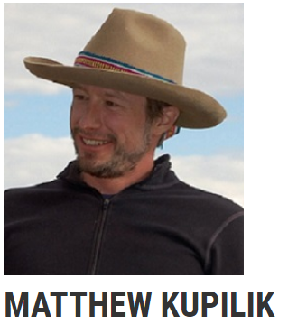
Computer Vision Stream Gauge
Faculty Advisor
Blair Munro and Katarina Godden

Slide 2
Notes:
all about water levels
measure with stream gauges in AK and US, grey
levels relate to, rainfall, icemelt, stream flow
how gauges work
traditional

Slide 3


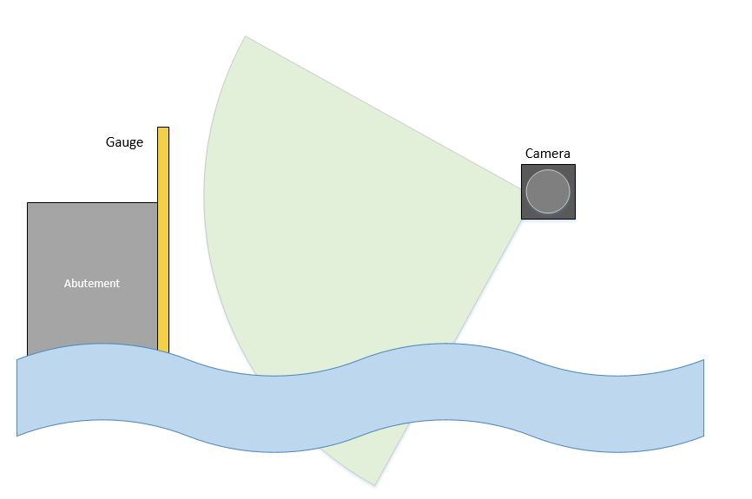
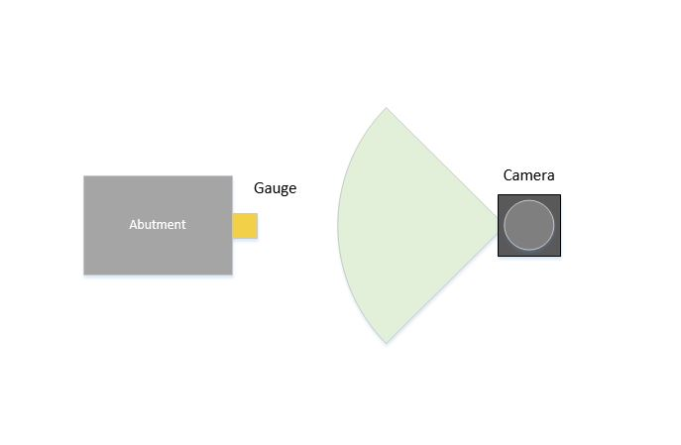
Introduction
What we will do
Notes:
nowadays, cameras
our goal: camera method + simplicity, like picture

Slide 4
Test Case
Whittier Alaska
Notes:
PIC – our case in reality, this is gauge CookInletkeeper installed
Whittier harbor, rectangle, camera, ~90’, wireless
our job to access to camera images via Gdrive, establish a baseline, then measure levels using software

Slide 5
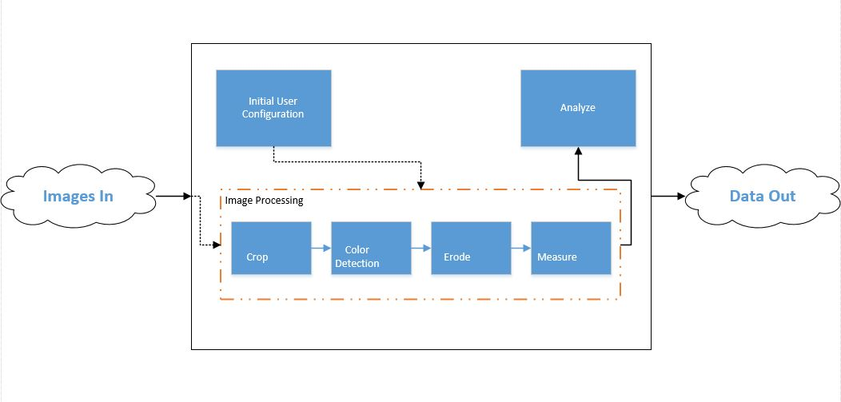
System
Notes:
Images are loaded into the script
The Initial user configuration is done one 1 image. This specifies the crop window, the color detection area, and the pixels to feet conversion.
Using the output values from the initial user configuration, the rest of the images are processed.
This involves cropping, color detection, image erosion, pixel measurements
The measurements are then analyzed to find the height of the water.

Slide 6

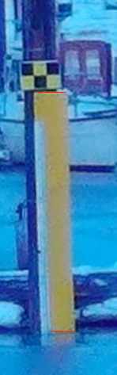
Baseline
Notes:
Nine images were chosen deliberately to represent a large spectrum of water heights and lighting conditions
Time stamp problem
How we marked and measured baseline

Slide 7
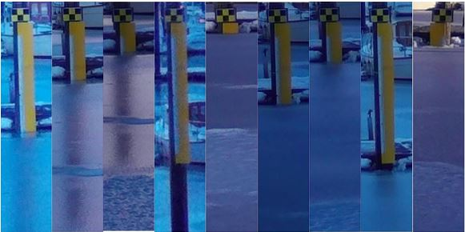
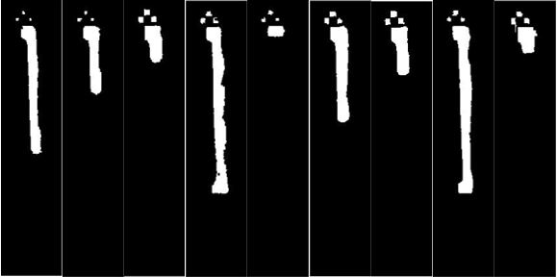
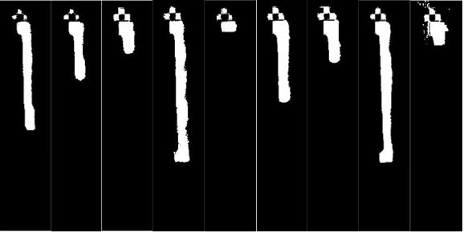
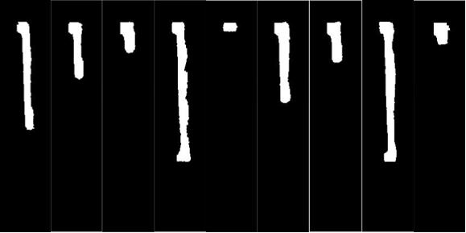
Processing
1.
3.
2.
4.
Notes:
Images Cropped
Color detection – average color and thresholding
Erosion – structure elements
Final

Slide 8
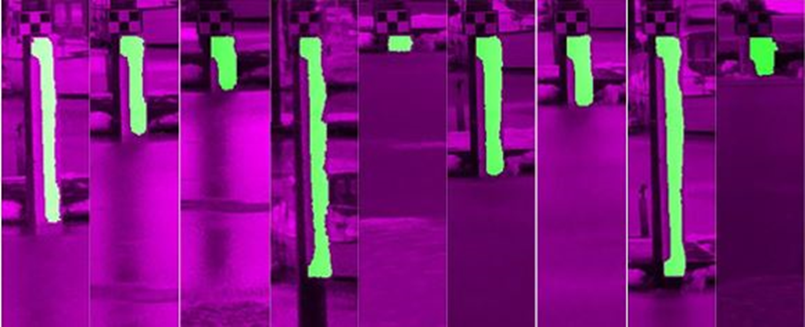
Processing
Notes:
Images overlayed.

Slide 9
Measurements
Notes:
The image is searched from the top and bottom
Linear height vs area analysis

Slide 10

Uncertainty
Notes:
close look at top and bottom marks
by eye, uncertainty in pixels
our case, ±4, ie ± 1”

Slide 11
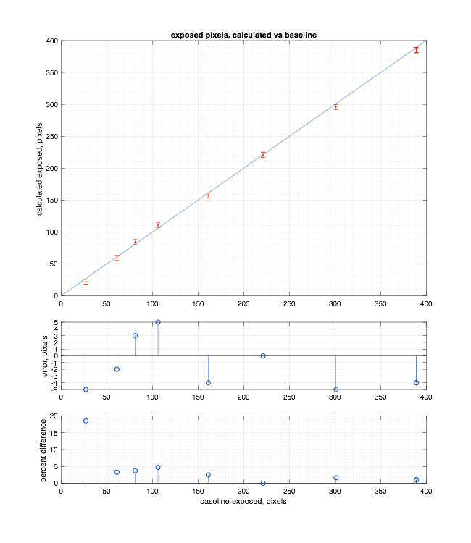
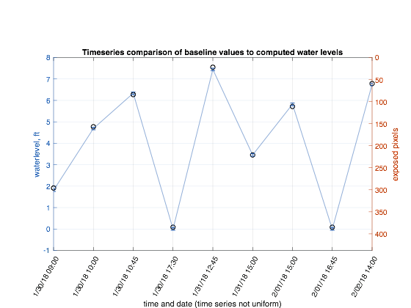
Results
Notes:
LHS: baseline over time, intro to waterlevel / pixel inverse relationship
RHS: baseline / measured comparison against expectation
systematic negative error
sensitivity to error for low water levels

Slide 12
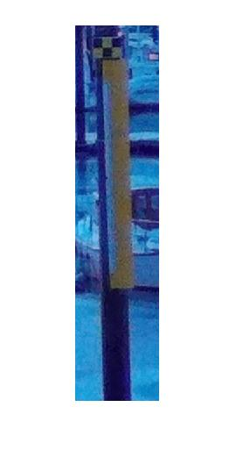
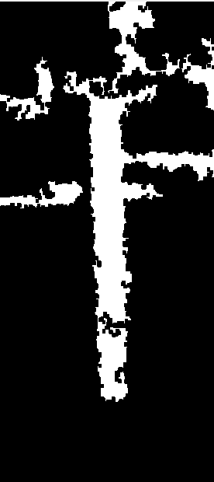
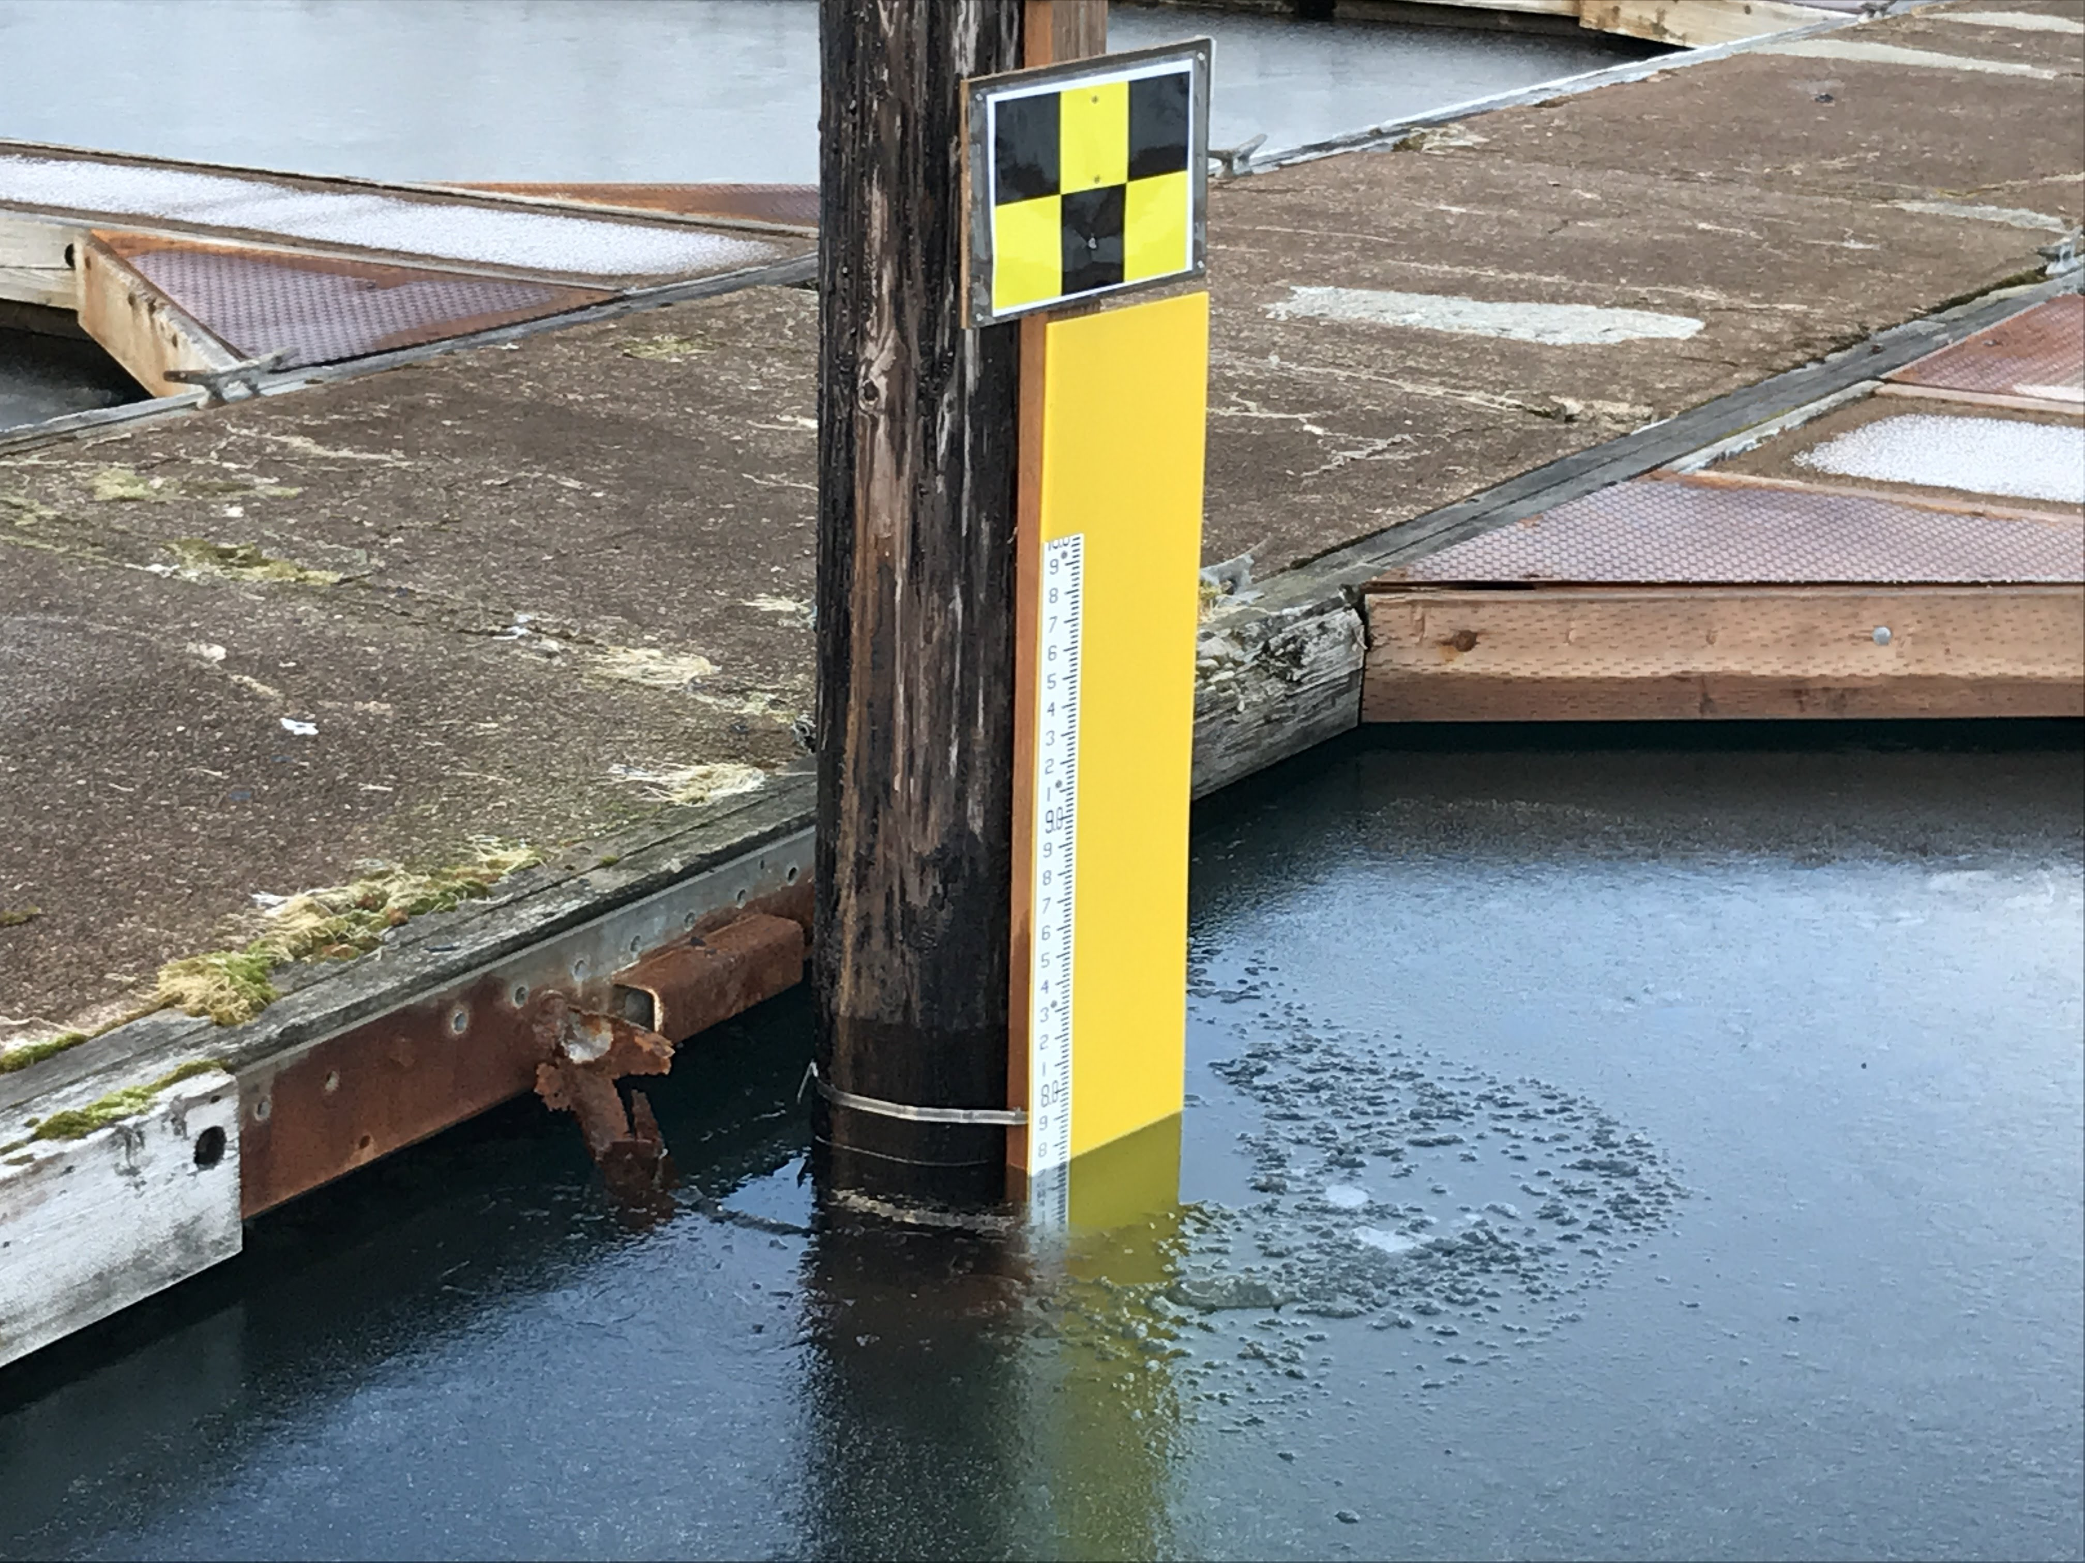
Limitations
Notes:
Perpendicular requirement
Full gauge showing/ full gauge covered
Night / low light
Gauge obstuctions / algea
reflections

Slide 13
Future work
Images could be batch or live streaming to the cloud from each gauge
Notes:
cloud magic
porting
extension to arbitrary setup configurations
error mitigation
calibration

Slide 14
Demo

